Slide 2
The Operating System: Windows
The installation takes time and so please make sure you have enough time
Make sure that you have the zipped file, to be more precise the gz file already downloaded and in your Downloads folder
Note that this zipped file is very large almost 18 GB !
If you have a Windows Operating System or a virtual machine that has Windows OS please skip to slide 5
We cannot install Vivado on Mac computers
We have to install a virtual machine which runs on Windows or dual boot your laptop with windows
If you have a Mac Please continue with next slide

Slide 3
Installation on Mac computers
One option is to buy a professional virtual machine, such as Parallel desktop software .
$40 for 1-year subscription for students, free 14-day trial
There are other similar software like
VMWare Fusion (Paid)
VirtualBox (Free).
You can also install windows directly on Mac with Boot Camp
You may need an activation key of Windows
There are some limitations without activation, like watermark and no personalization
But it will not affect the installation and use of Vivado

Slide 4
Installation on Mac computers
In summary, you can use one of the options
Video link of Install Windows 10 using Parallels Desktop for Mac (Paid software, easy to install)
Video link of Installing VirtualBox and Windows 10 on a Mac (Free software but requires lots of settings)
To use boot camp to install Windows 10, follow the instructions provided by Apple

Slide 5
For all laptops, it is time to work on the Vivado now
If you downloaded the Vivado tool from the Xilinx web site, please skip to slide 6
Otherwise, access the Xilinx website
Scroll down and find the Full product installation in the page
Note that eventually, you will create a Xilinx account to acquire the license after the installation is completed
2018.3
2018.3
The last one, the single-file installer, is provided in the lab to reduce your download time
If you are at home, you can download the first one and the files needed will be downloaded later

Slide 6

If you use the single-file installer, it should be a gz file
Right click on the tar file select 7-zip and then select Extract Here
The gz file is converted to a tar file
Perform another 7-zip + Extract Here operation to have the unzipped folder
Go to path: ”Downloads\Xilinx_Vivado_SDK_2018.3_1207_2324”
Double click on the xsetup.exe file
Allow it make changes to your computer and it should open up a window shown in the next slide

Slide 7
Start of Installation
2018.3
Click on Next and agree to everything and click next

Slide 8
Select the Vivado HL Webpack
2018.3

Slide 9
Accept the default settings. Click on Next
2018.3

Slide 10
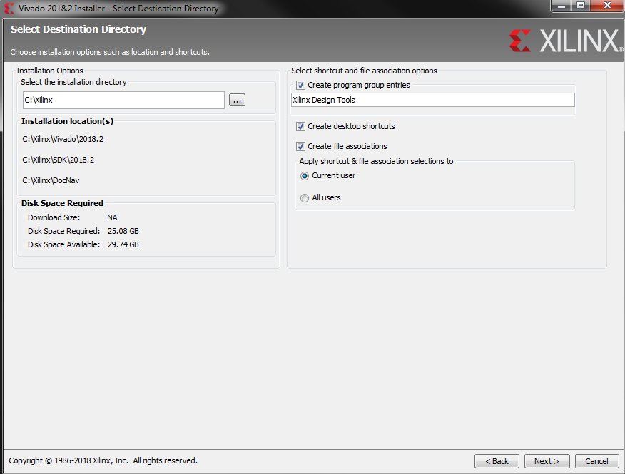
Accept the installation location and other choices made and click Next.
2018.3

Slide 11
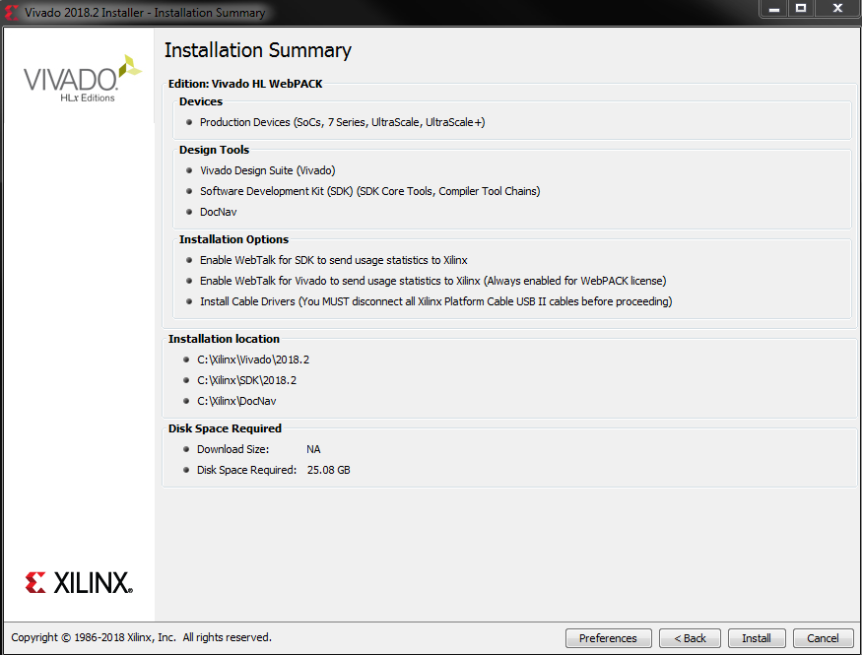
Accept the Installation Summary and click Next.
2018.3

Slide 12
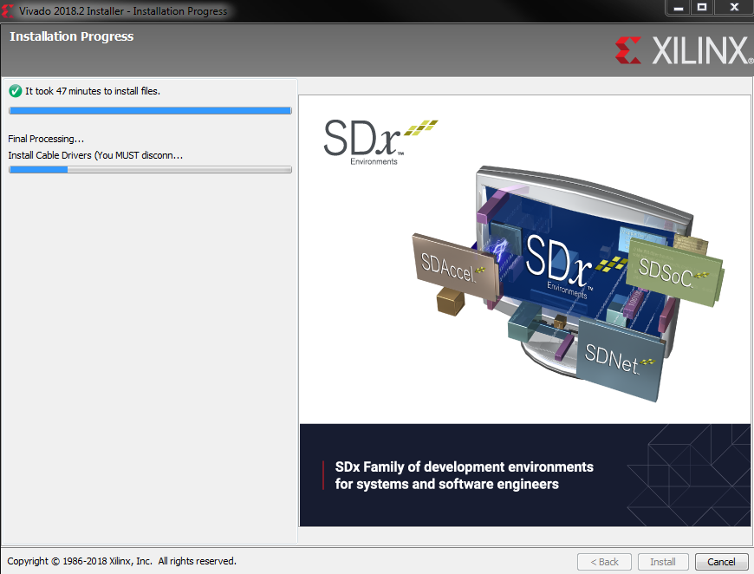
Wait for the installation completes you may see the window below if you do not have a USB device or an FPGA board is connected :
2018.3

Slide 13
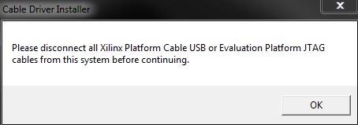
But, if you have USB devices, FPGA boards connected to your laptop, you will asked to disconnect them : Disconnect them and click OK for the disconnect action
2018.3

Slide 14
As the installation continues, you may be prompted windows about trusting software from a certain company like the one below
Click on Install and wait for the final processing
2018.3

Slide 15
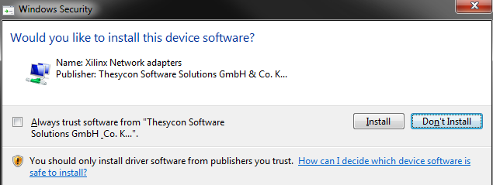
Or the following question where you are asked to click on Install and wait for the final processing.

Slide 16
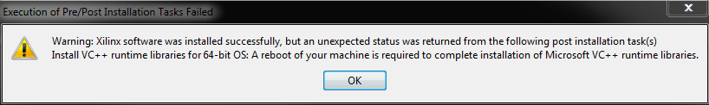
You may get the following warning where a reboot is required before completing the installation successfully
Click OK to reboot your computer

Slide 17
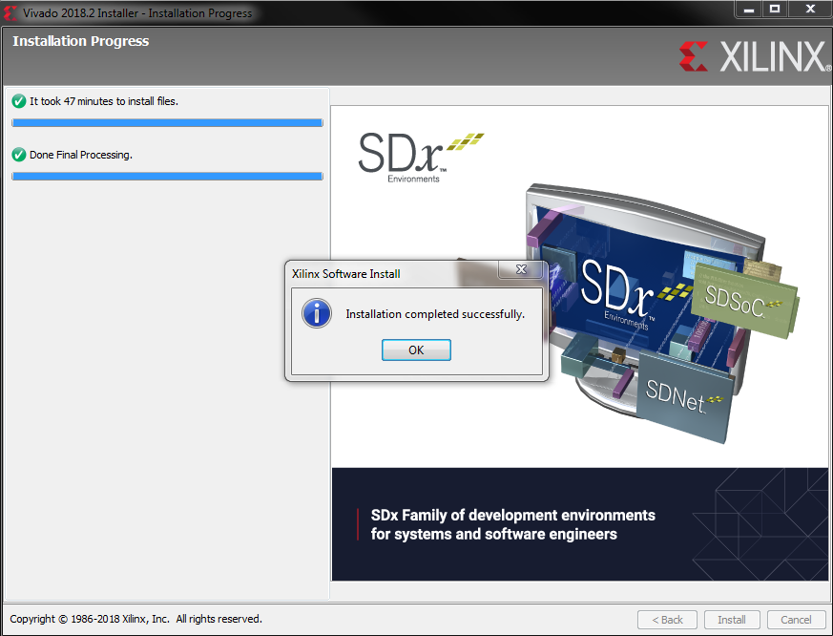
However, you computer will not be rebooted and you will see the following on your screen :
Click OK
2018.3

Slide 18
Once completed, Vivado and Vivado HLS icons will appear on the desktop
Open Vivado
Click on Help – Click on Obtain a License key
2018.3

Slide 19
In the License manager, choose Get the free one
Click on connect now
In the open browser, sign in or create an account
Enter your information following the instructions
Make sure to provide your NYU email address to get the license file
2018.3

Slide 20
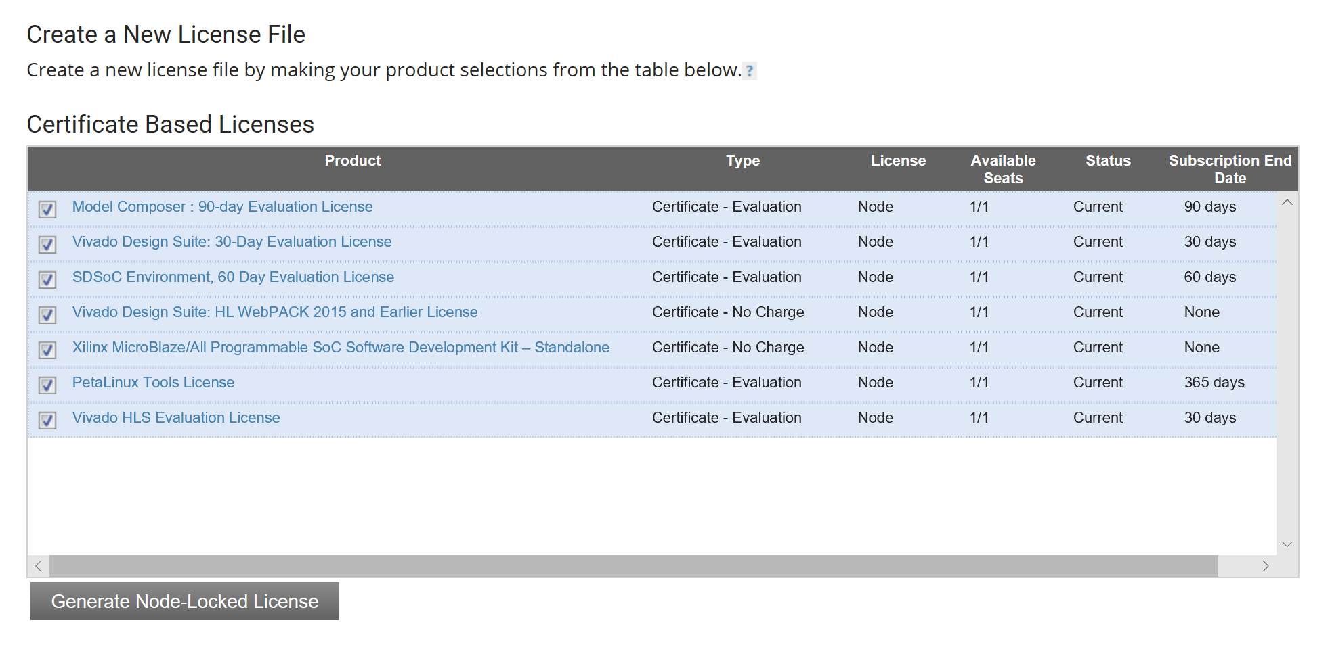
On this page, check all the boxes and click on Generate License
As you can see, some Licenses expire soon
So, you may do these steps again once they expired

Slide 21
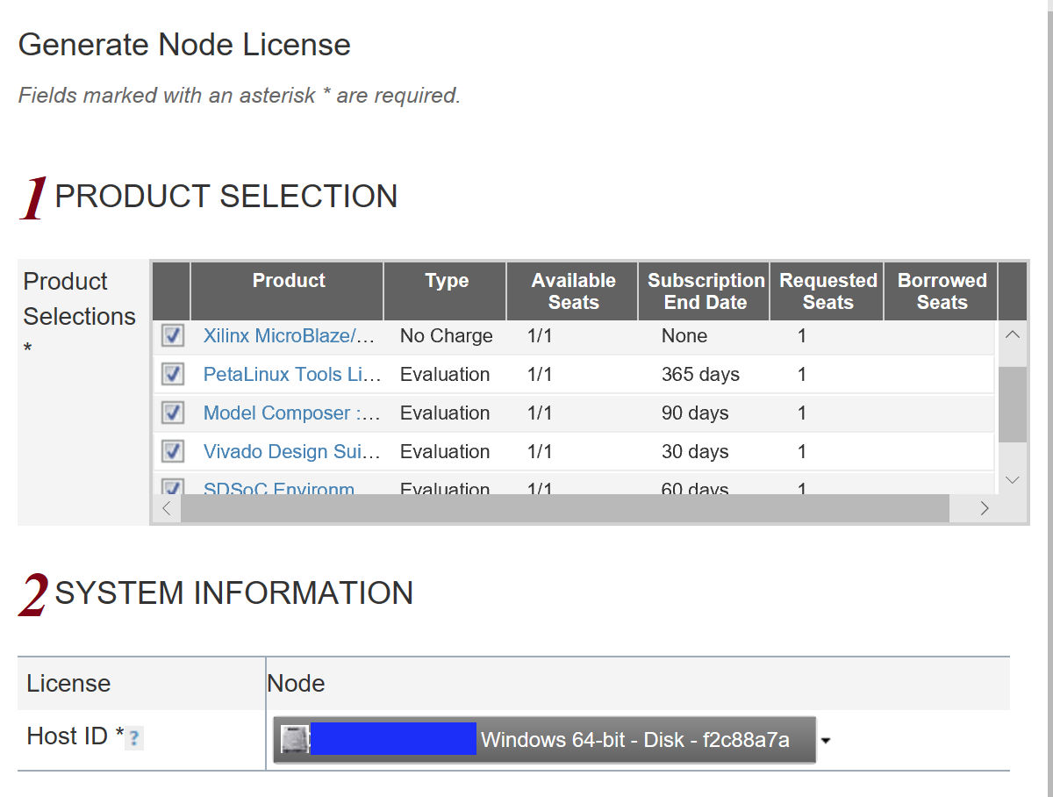
Select your PC in the system information
You will select your computer’s disk serial number which is similar to what you see below for an example computer
Then click on Next
When you are prompted with the Review License Request window, review your request and then click Next

Slide 22
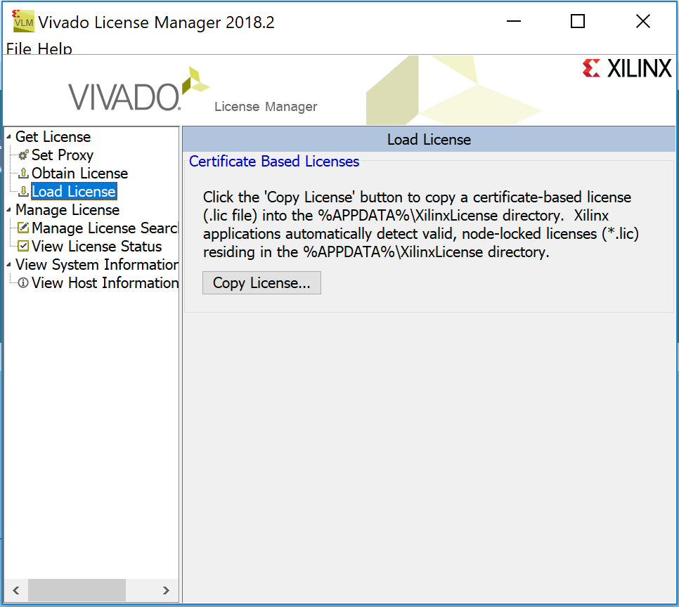
You will be shown a window that has Congratulations on its first line and then the list of products for which the licence file is sent for
Close this Congratulations window
Minimize the web page that is showing the Xilinx Product Licensing options
After the process in the browser finishes, the license file will be emailed to you. It appears in the email attachment as “Xilinx.lic”. Save it anywhere
Return to your Vivado License Manager window
2018.3

Slide 23
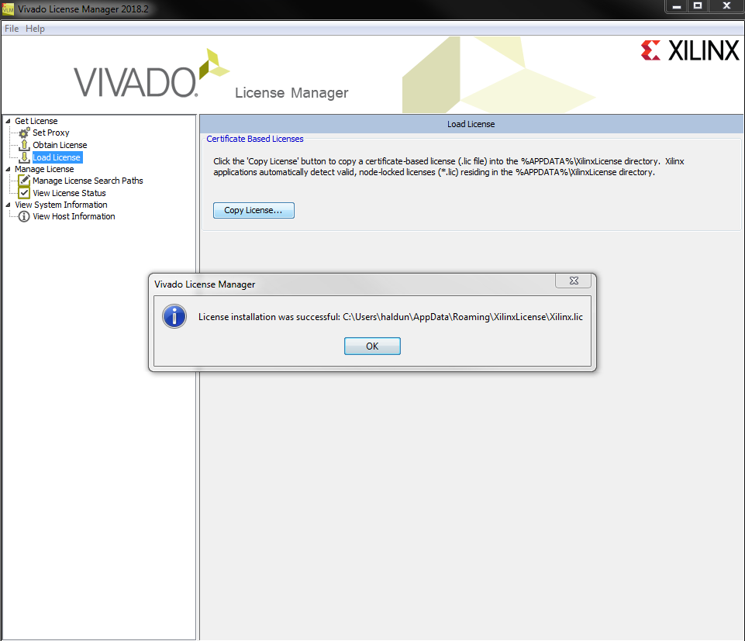
In the license manager, click on Load License
Then click on Copy License
Choose your key (the license file) saved earlier
Click Open
A window will pop up to indicate that the license installation is successful
Click OK
Close the Vivado License Manager window
Click Yes to exit the Manager window
2018.3

Slide 24
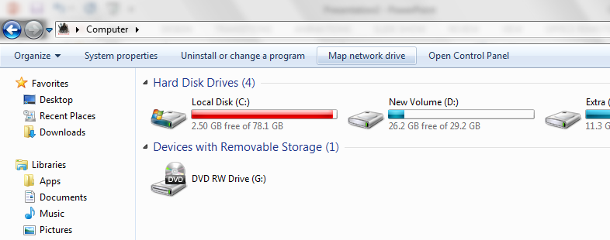
Adding S Drive for Windows users
Digital Logic students are recommended to use a network shared storage that is mounted as the S drive in lab machines
You can access this shared drive anywhere in the NYU campus
Otherwise, use NYU VPN to get access to it.
Go to my computer and you will see an option Map Network drive
Select the option

Slide 25
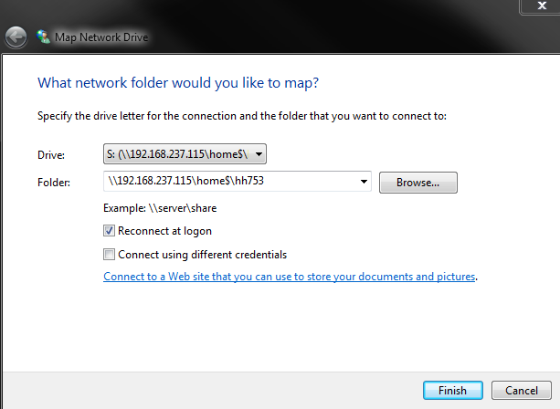
Select S as your drive
Give the following ip address followed by your netid
\\192.168.237.115\home$\netID
Login with your credentials
User name is your netid and the password
By default it is your N number or the one you set yourself
Off campus, you should be connected to the Tandon network using the NYU vpn
The network should either be private or work not public
This should create S drive and you should be able to access all the lab folders off campus (make sure you login to the NYU vpn first)

Slide 26
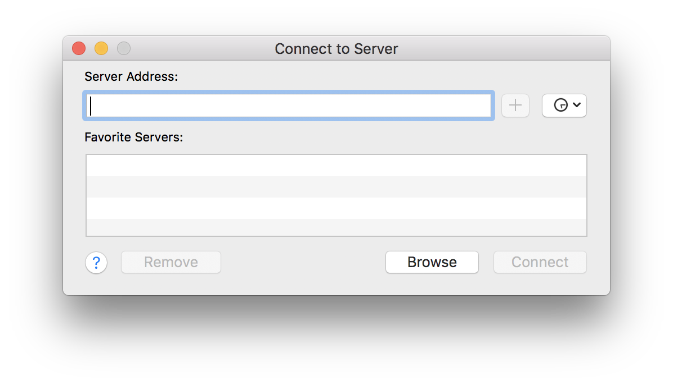
Adding S Drive for Mac users
Open Finder
Press command + K
At “Connect to Server” window, enter the server address. Note that the direction of slashes is different from Windows. On Windows it’s \\192.168.237.115\home$\yournetID but on mac it should be 192.168.237.115/home$/yournetID
Note: At the next time you open the window, the link will become smb:// 192.168.237.115/home$/yournetID. The “smb” prefix does not matter
Click connect and enter your username and password. The S drive will now appear as a tab in your finder. It’s recommended to keep this tab in Finder since you need to command + K again if you close it

